Slide 1

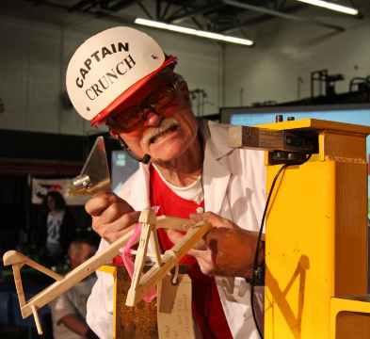
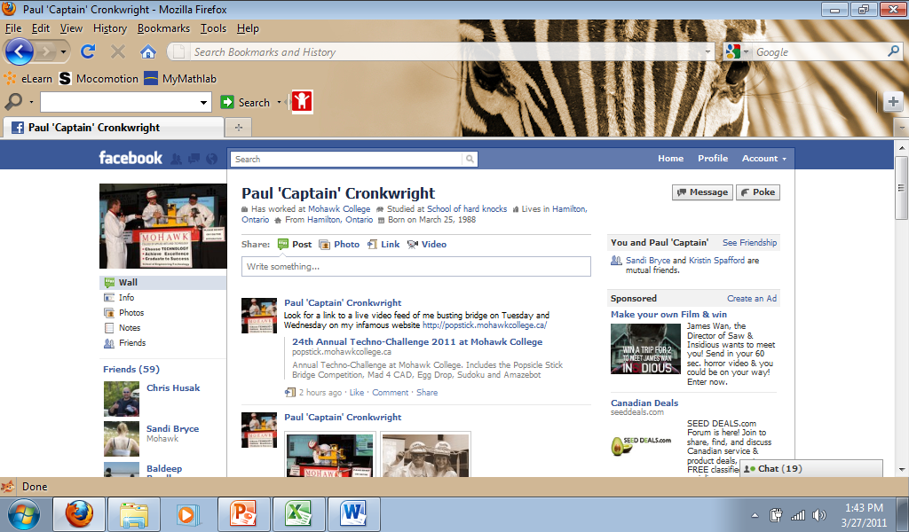
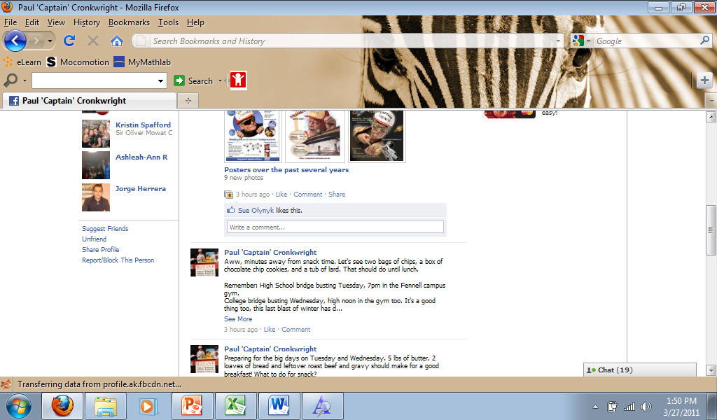


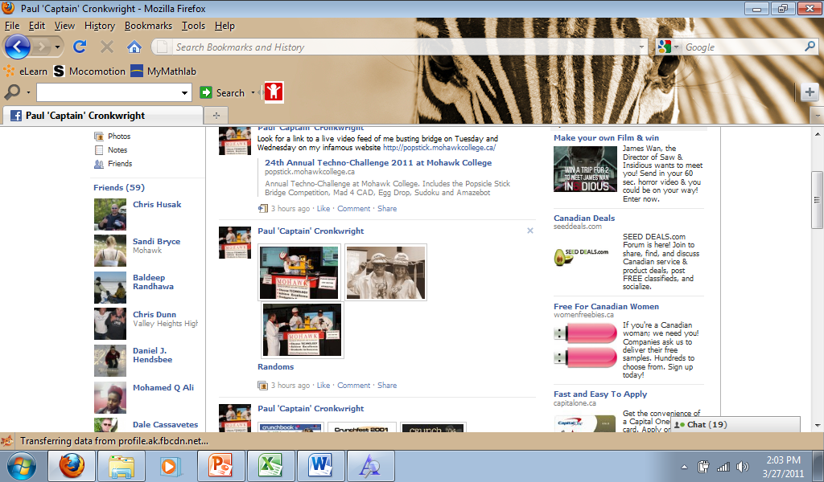

Paul ‘Captain’ Cronkwright
CRUNCHBOOK 2011
Pictures of the 2011 College students who thought they won. I just give them a parting gift to keep them from crying on my busting machine!

Slide 2
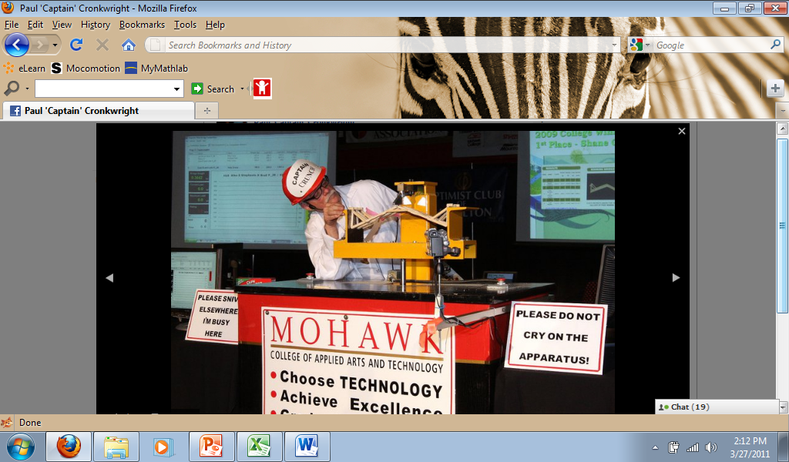
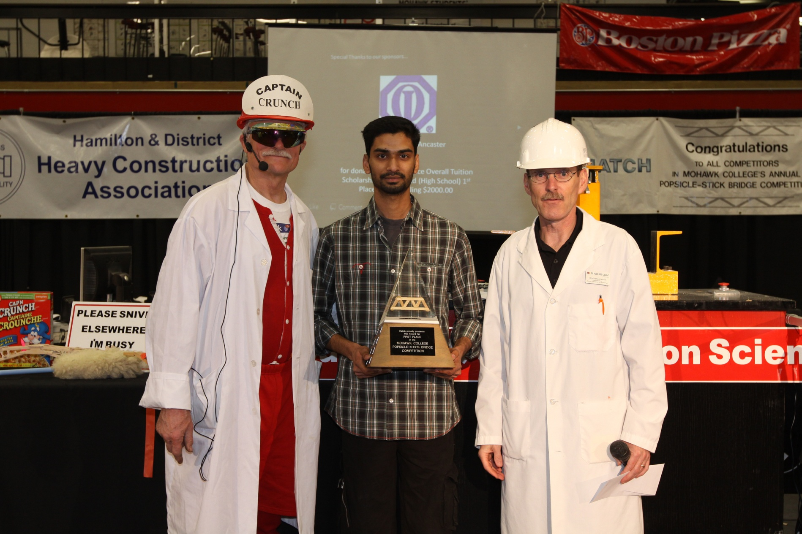
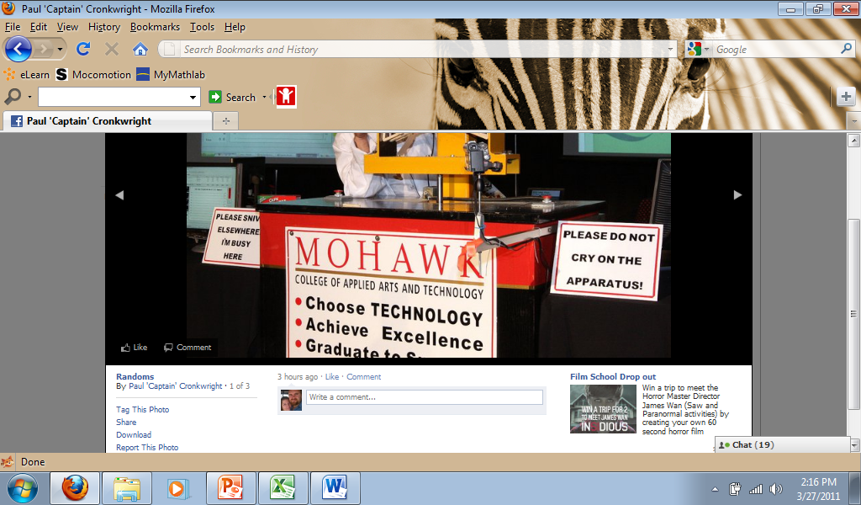
1st Place Overall: Peter Dimitroulias and Thomas Plammoottil

Slide 3
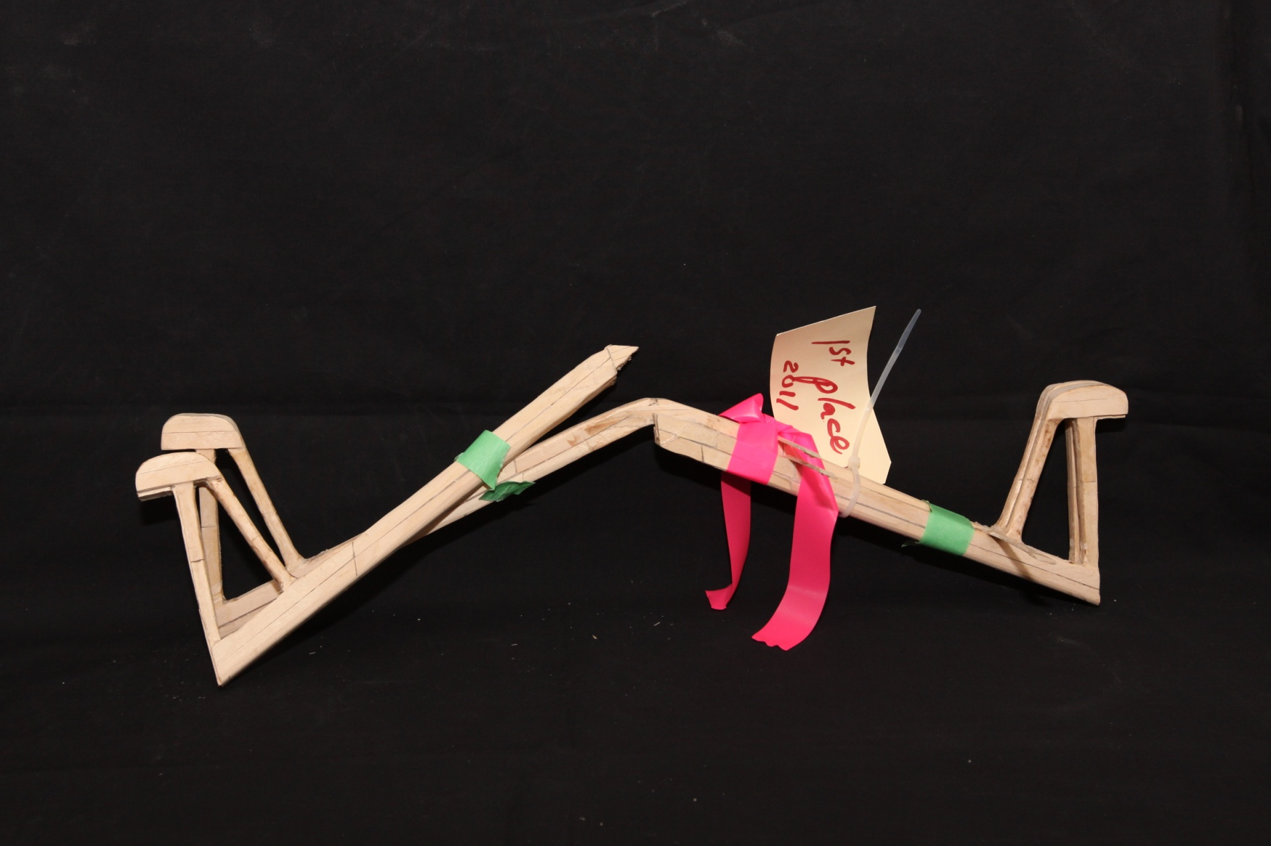
1st Place Overall
Bridge Weight = 249.3g
Performance Rating = 3637.2 times own weight

Slide 4
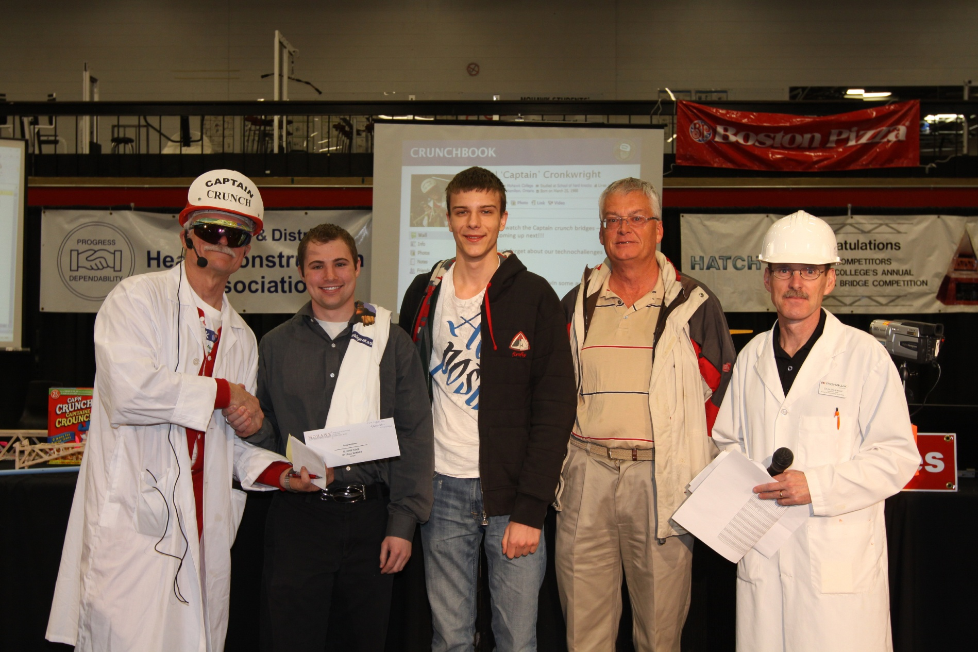
2nd Place Overall: Colin Cybulska and Alexandru Voinescu

Slide 5
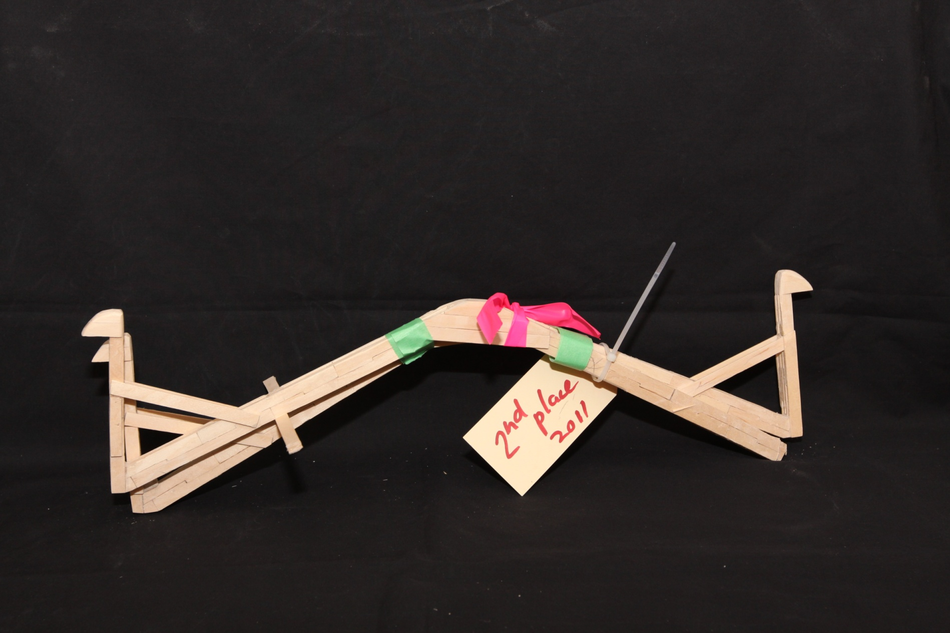
2nd Place Overall
Bridge Weight = 230.1g
Performance Rating = 3548.6 times own weight

Slide 6
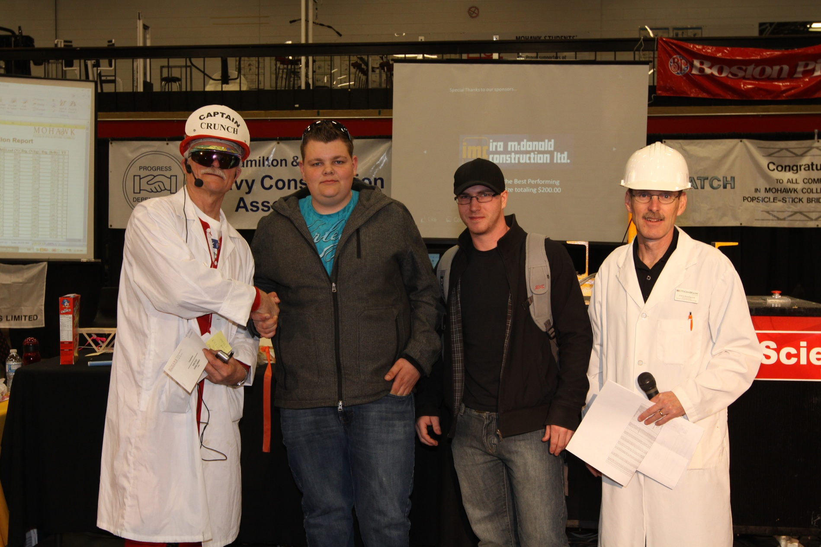
3rd Place Overall: Travis Vanderkooy and Will Bowes

Slide 7
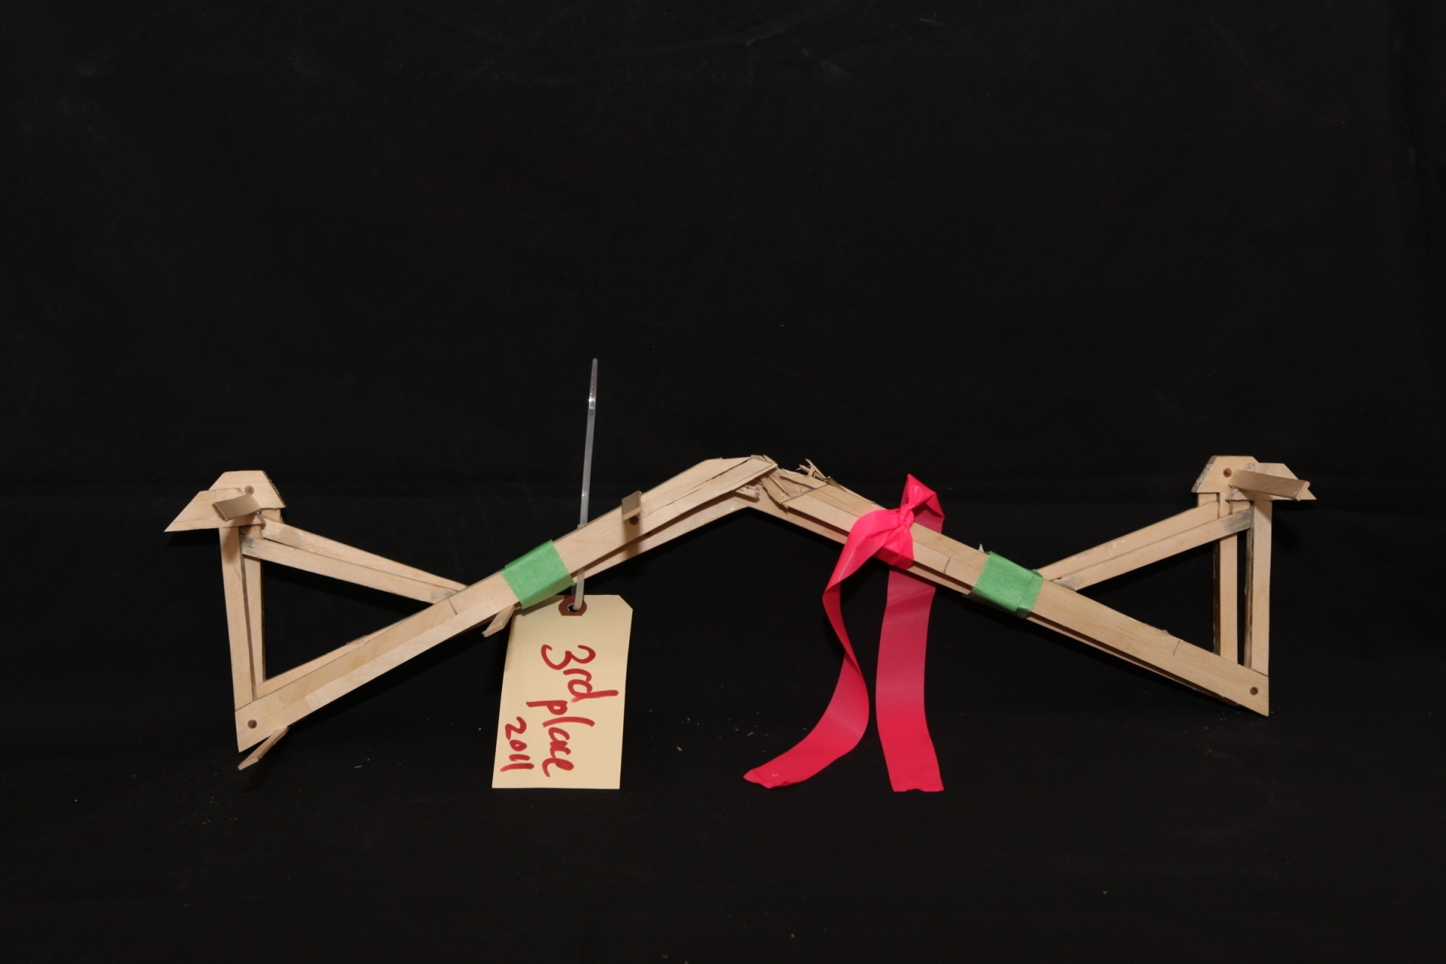
3rd Place Overall
Bridge Weight = 234.2g
Performance Rating = 3373.5 times own weight

Slide 8
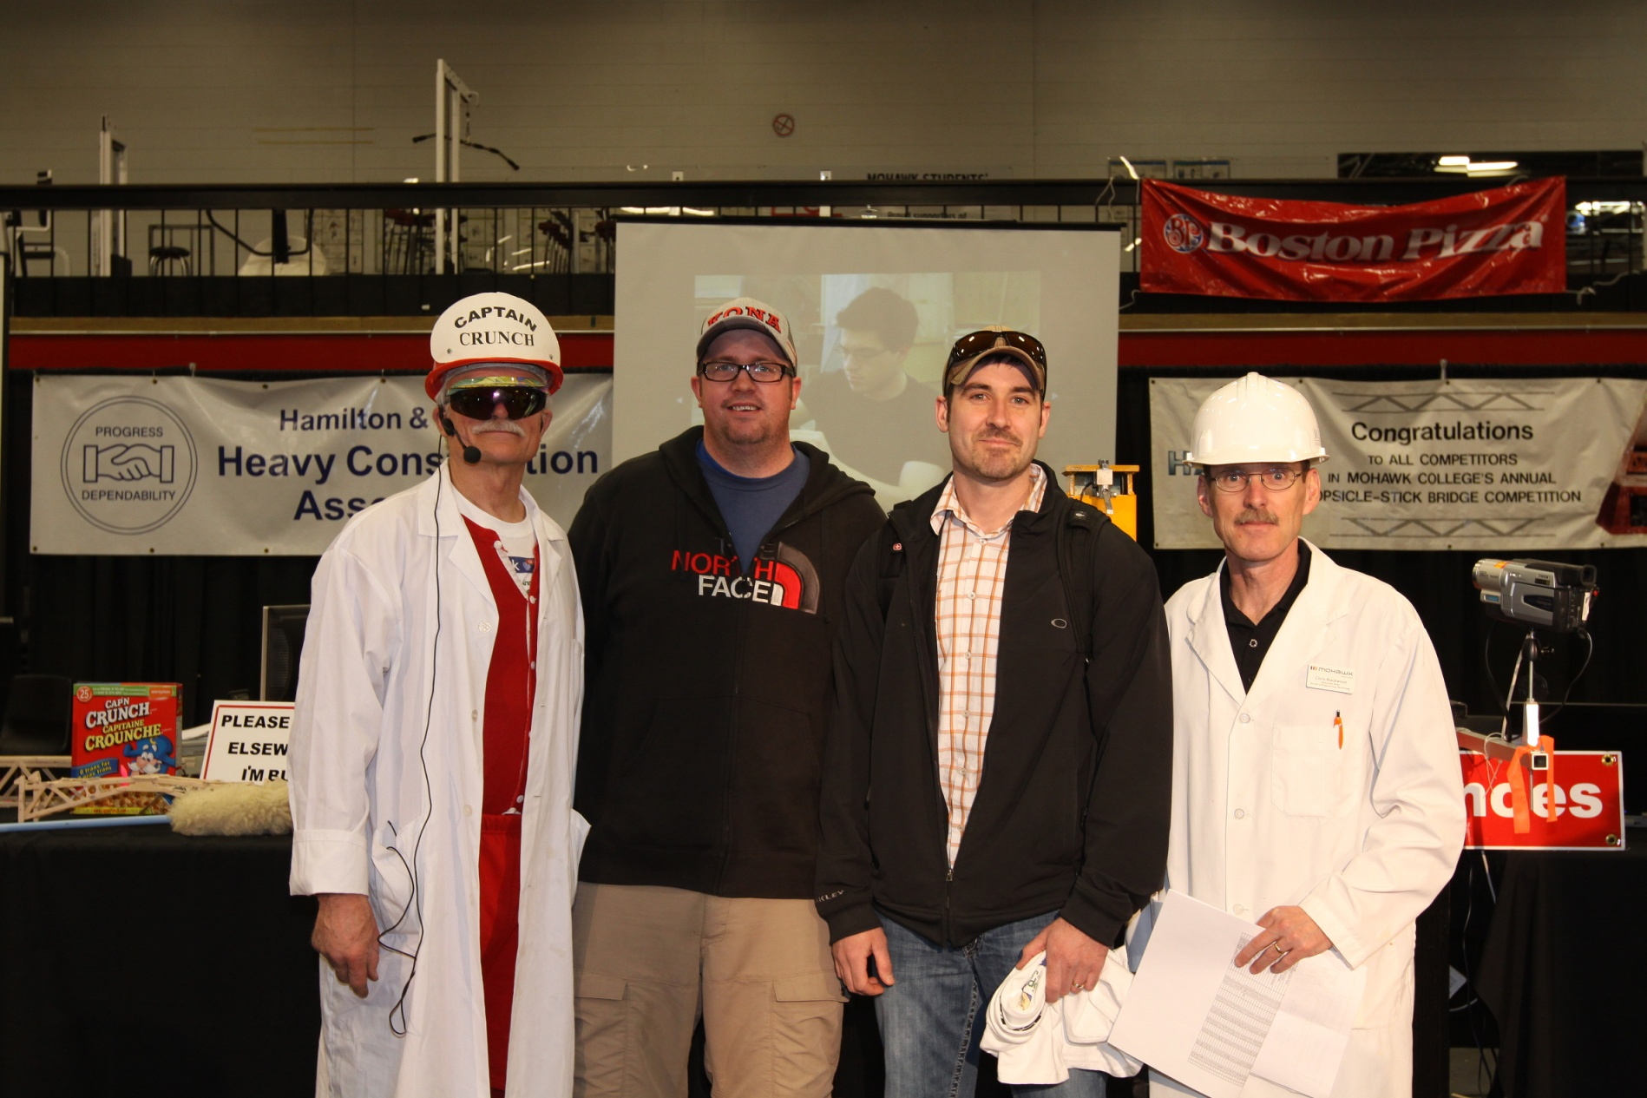
4th Place Overall: Richard Monaghan and Dave Lampman

Slide 9
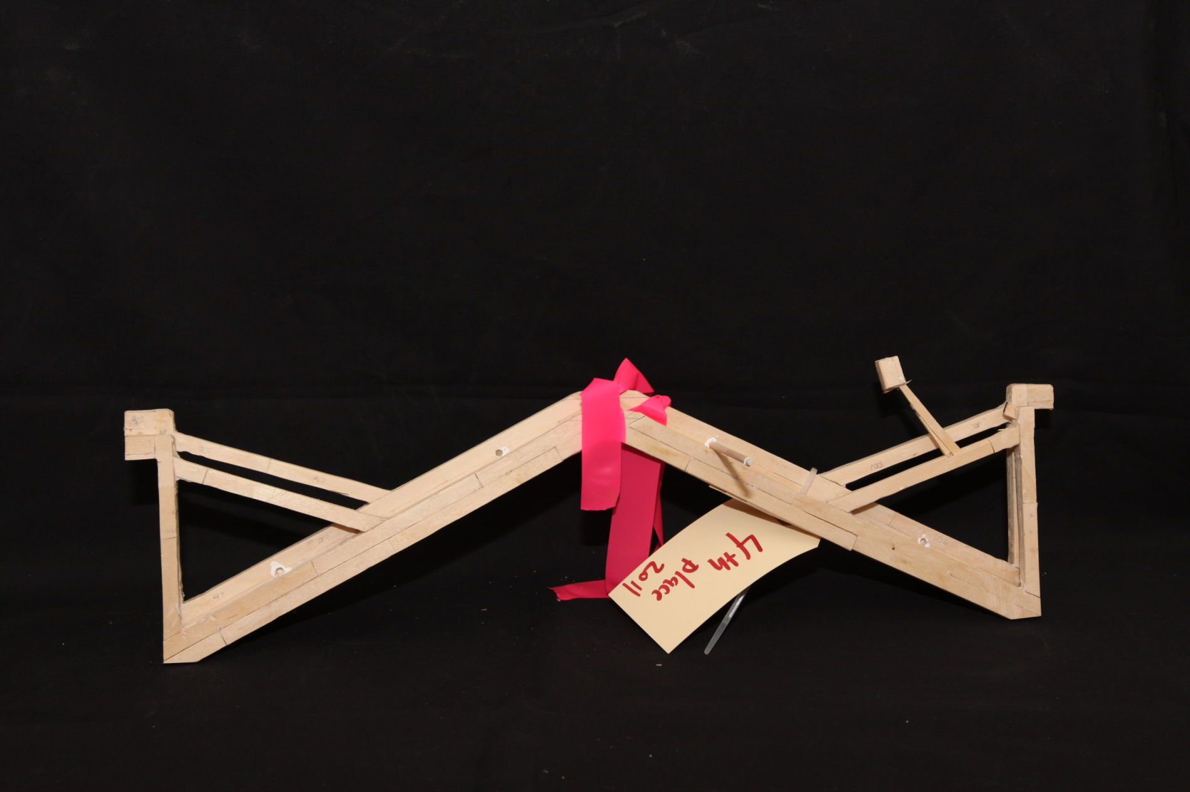
4th Place Overall
Bridge Weight = 222.9g
Performance Rating = 3117.3 times own weight

Slide 10
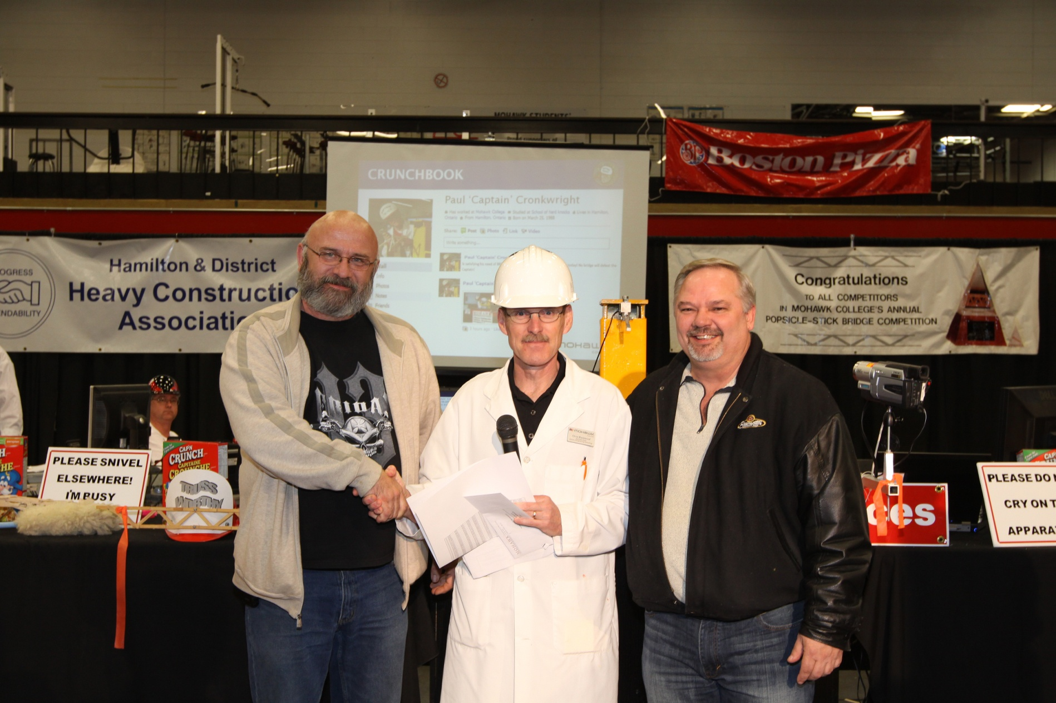
5th Place Overall: Dave Lees and Earl Wells

Slide 11
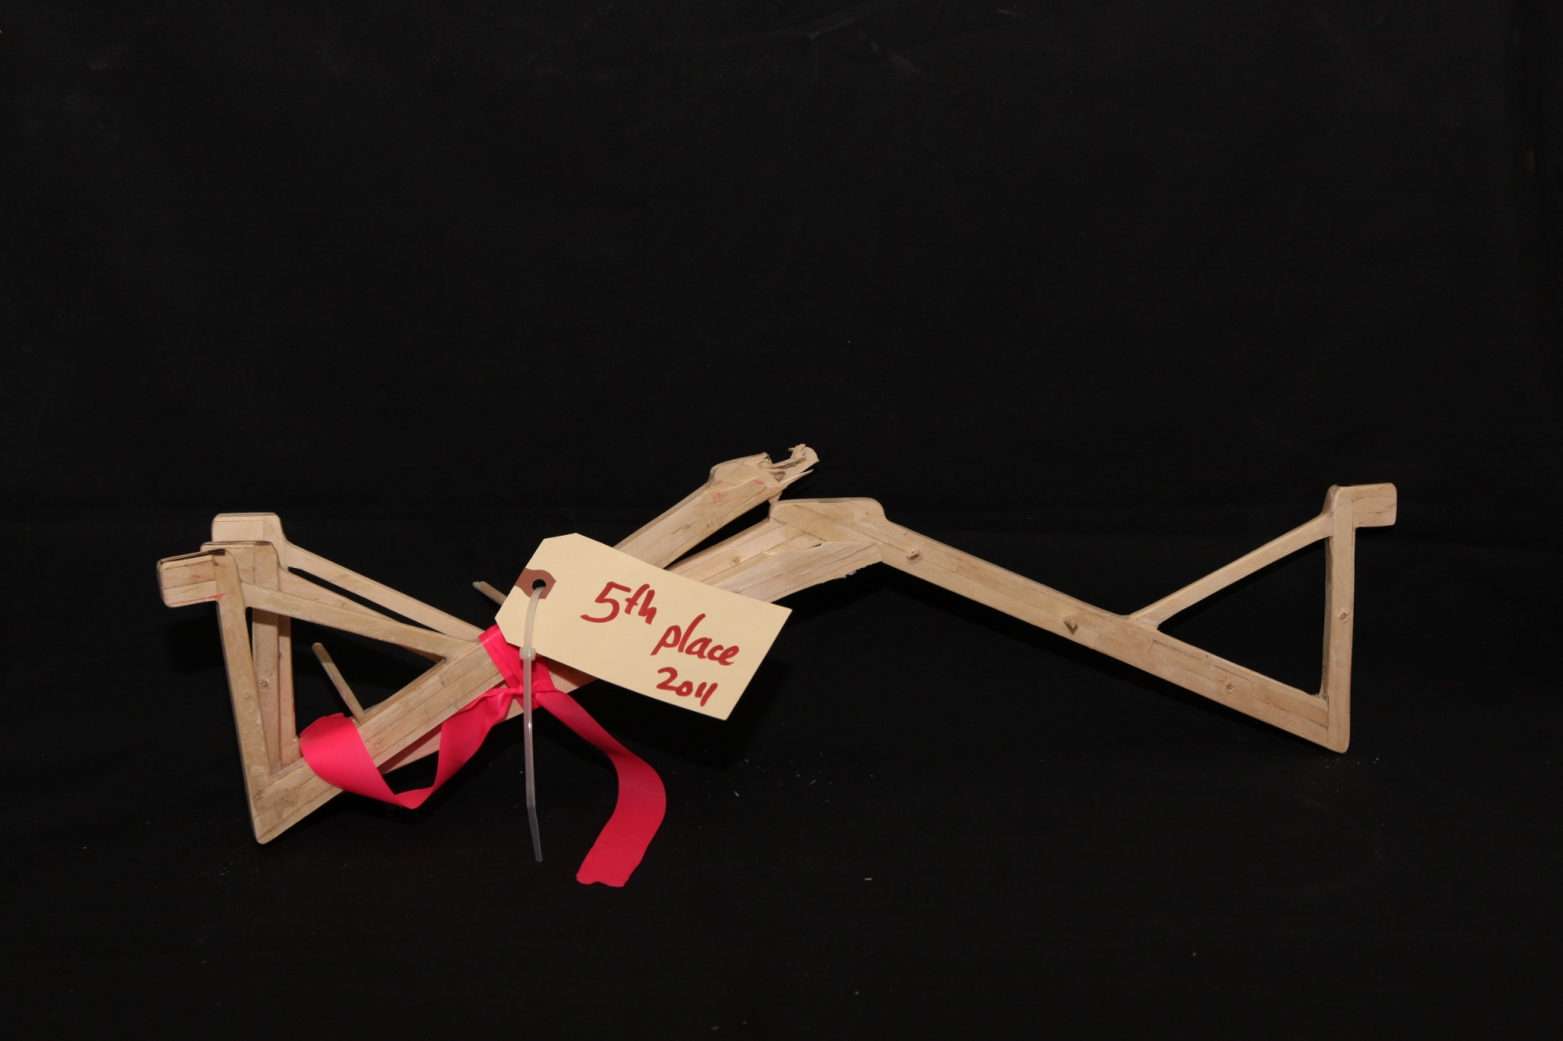
5th Place Overall
Bridge Weight = 224.0g
Performance Rating = 2956.9 times own weight

Slide 12
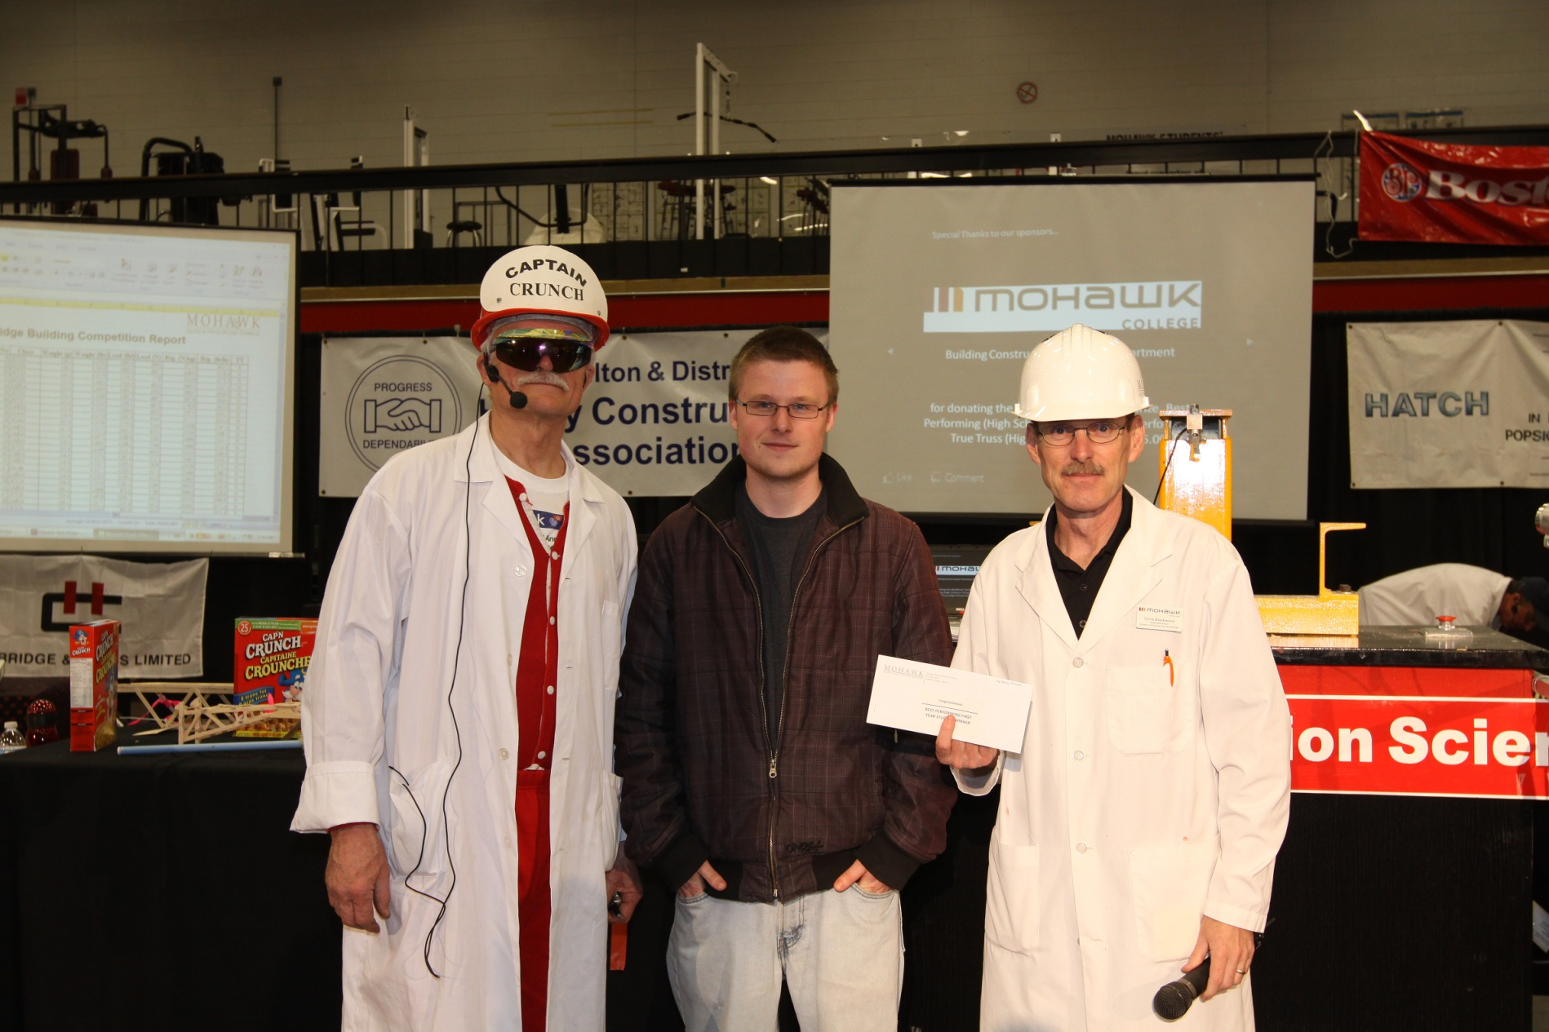
Best Performing 1st Year Student: Andrew Dale

Slide 13
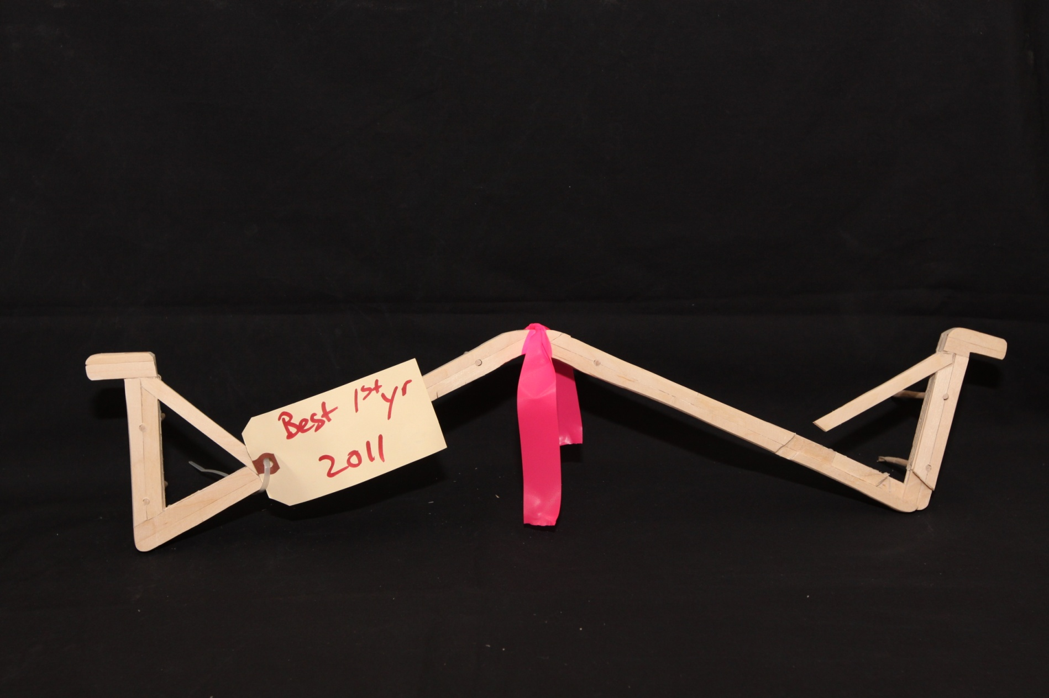
Best Performing 1st year student
Bridge Weight = 239.0g
Performance Rating = 2625.0 times own weight

Slide 14
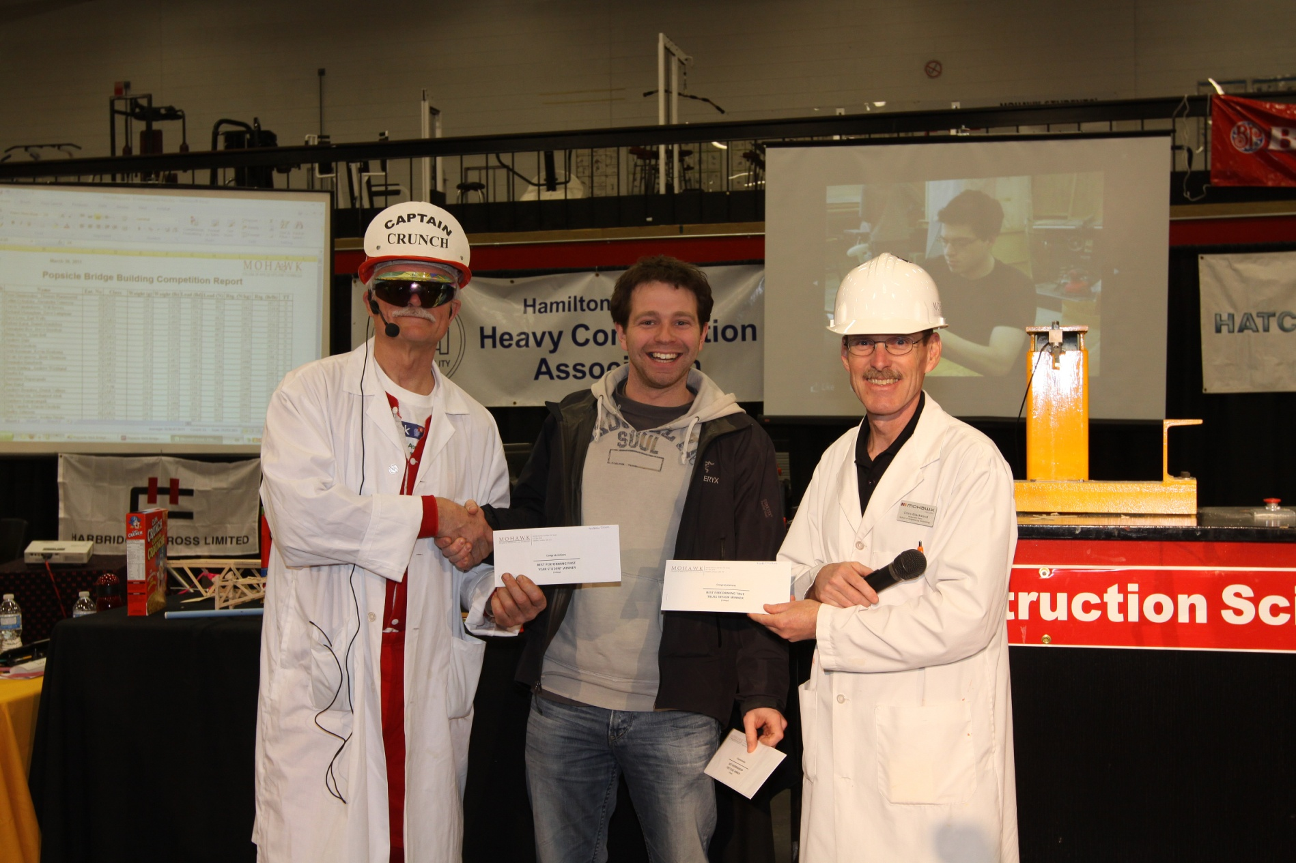
Best Performing True Truss, Best Workmanship 1st Place, and Best Aesthetics: Matt Coultes

Slide 15
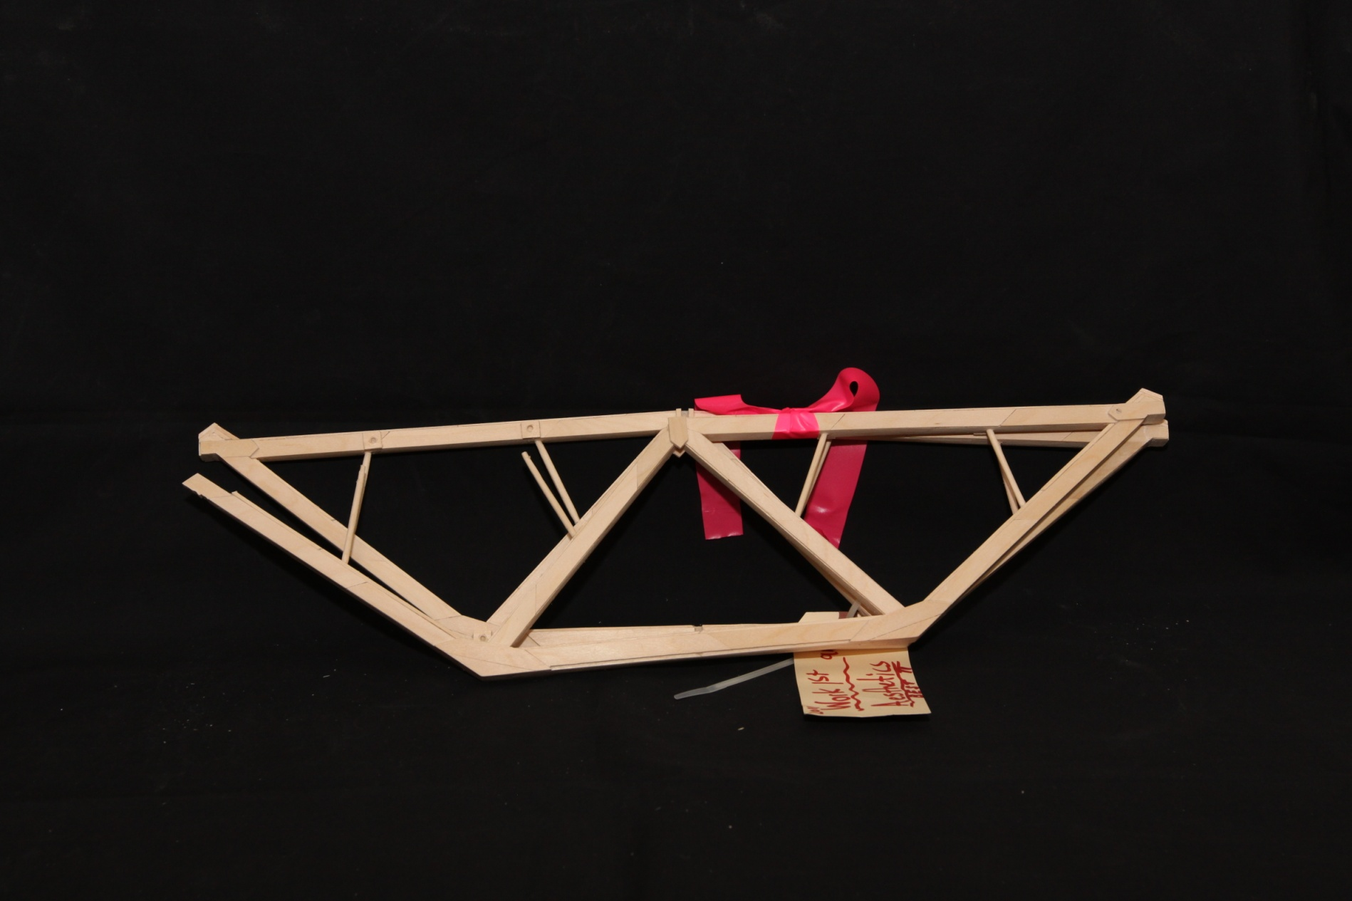
Best Performing True Truss, Best Workmanship 1st Place, and Best Aesthetics
Bridge Weight = 248.2g
Performance Rating = 1798.1 times own weight

Slide 16
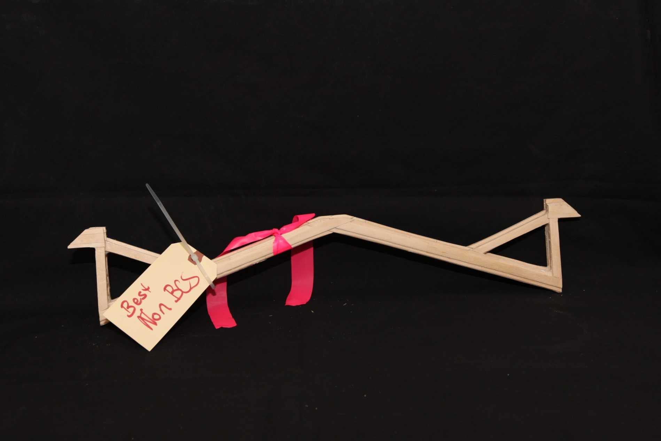
Best Performing Non Bldg. and Const. student: Mitchell Duhig
Bridge Weight = 139.2g
Performance Rating = 2024.1 times own weight

Slide 17
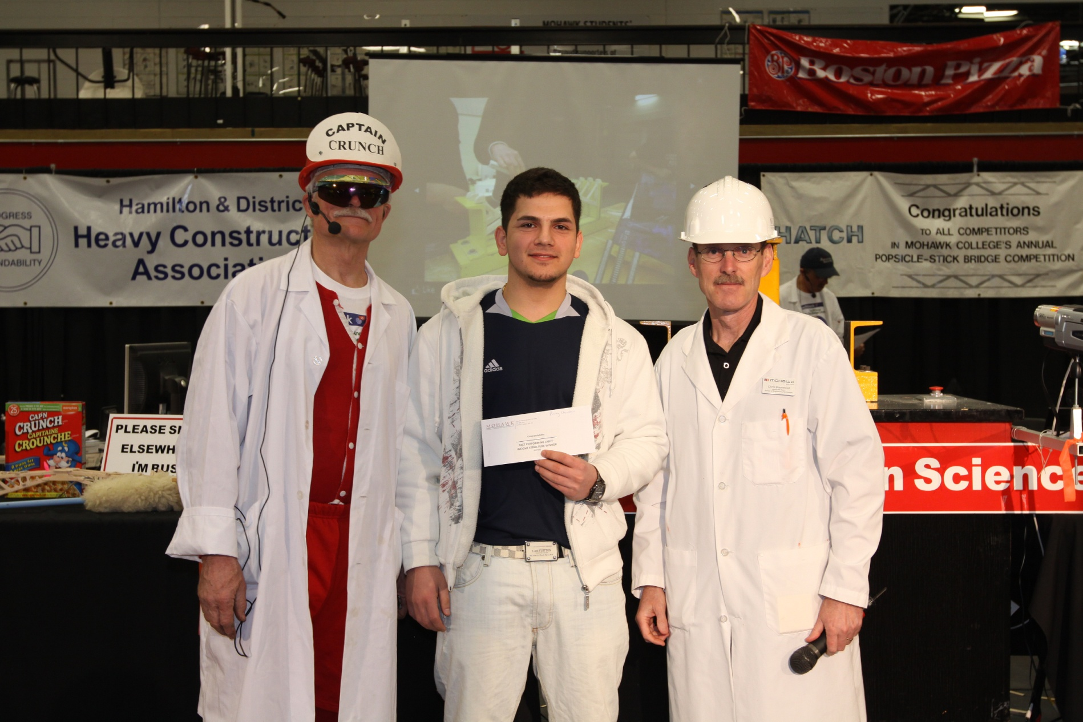
Best Performing Lightweight Bridge: Ramy Chawshin

Slide 18
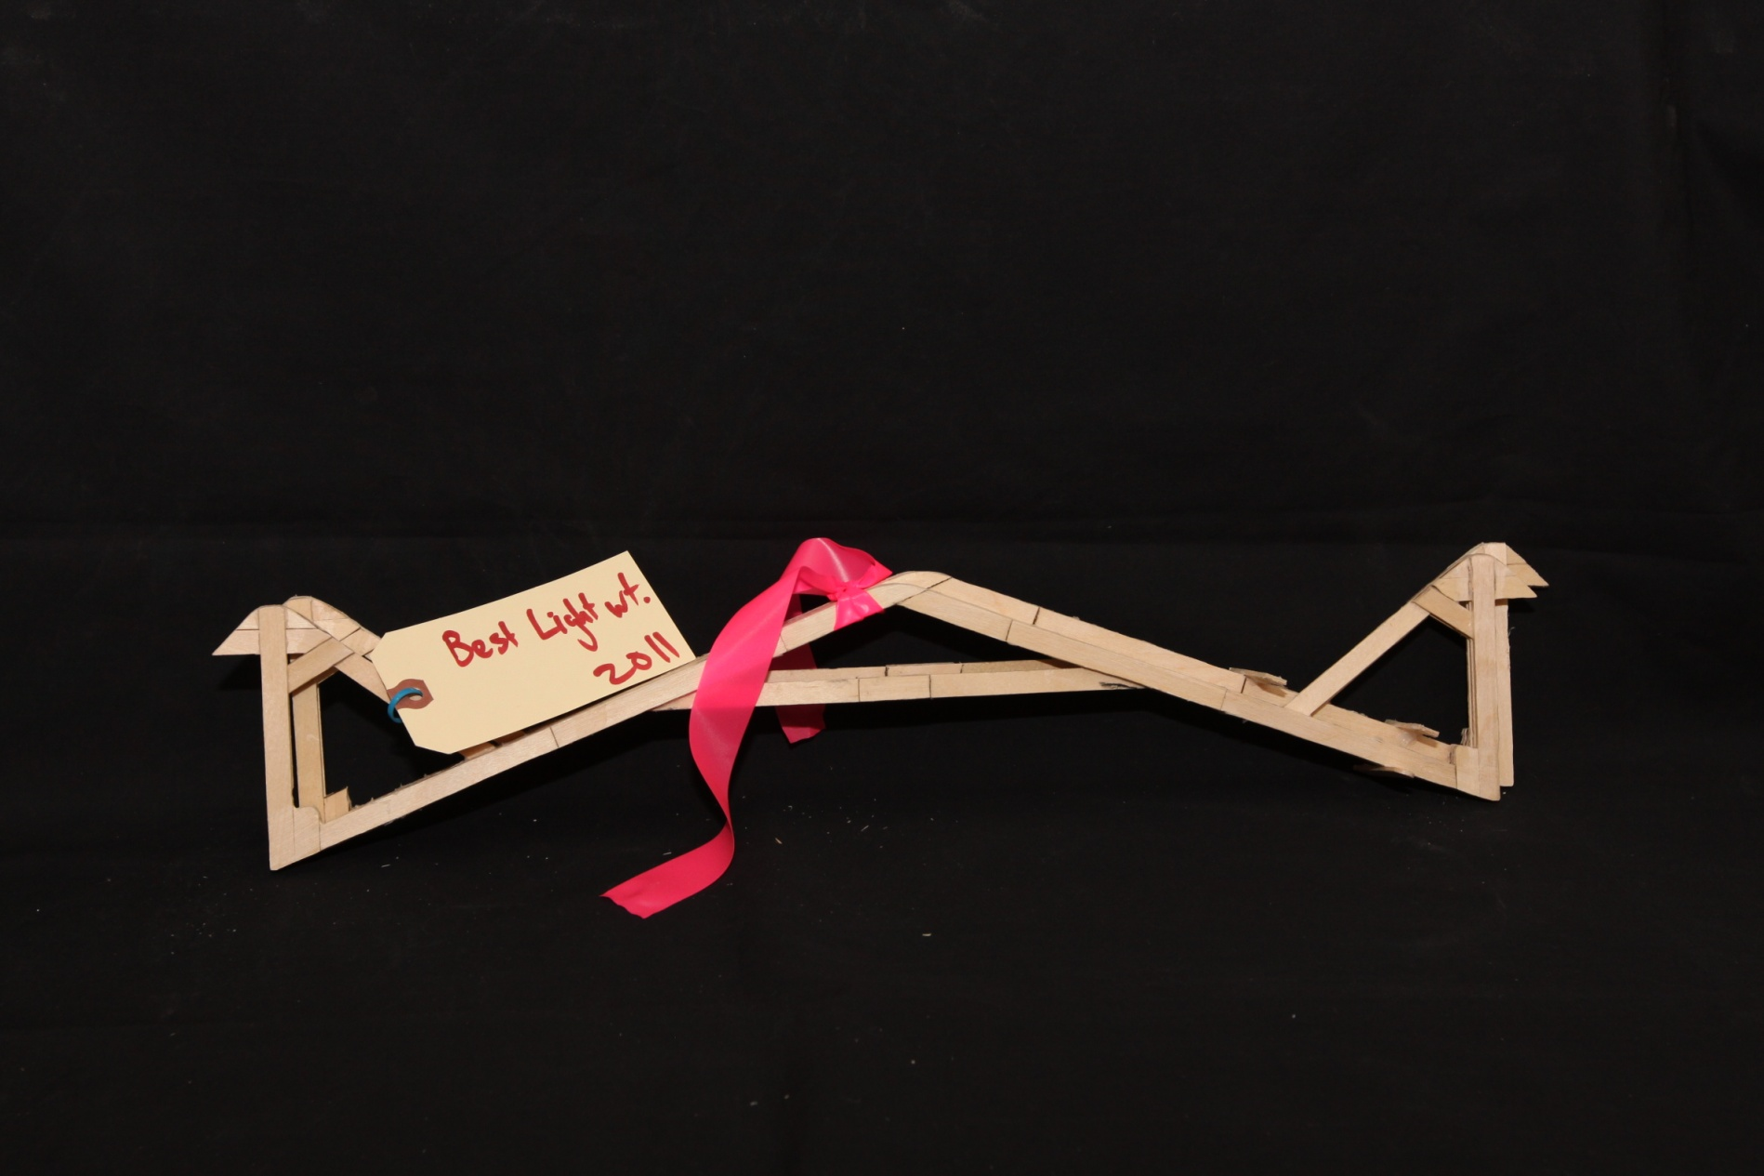
Best Performing Lightweight Bridge
Bridge Weight = 128.2g
Performance Rating = 2030.1 times own weight

Slide 19
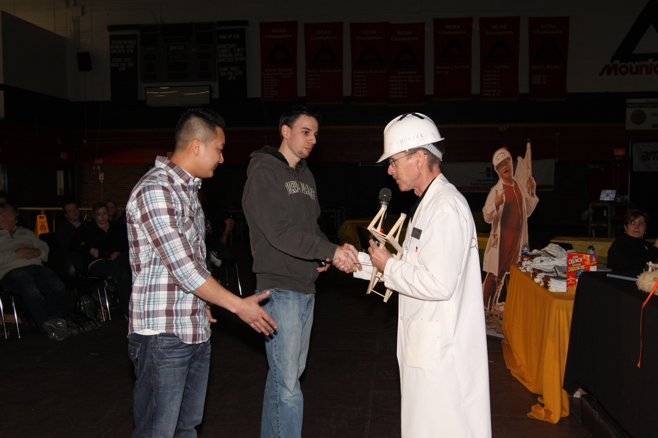
Best Workmanship 2nd Place: Hai Ly and Adam Purdy

Slide 20
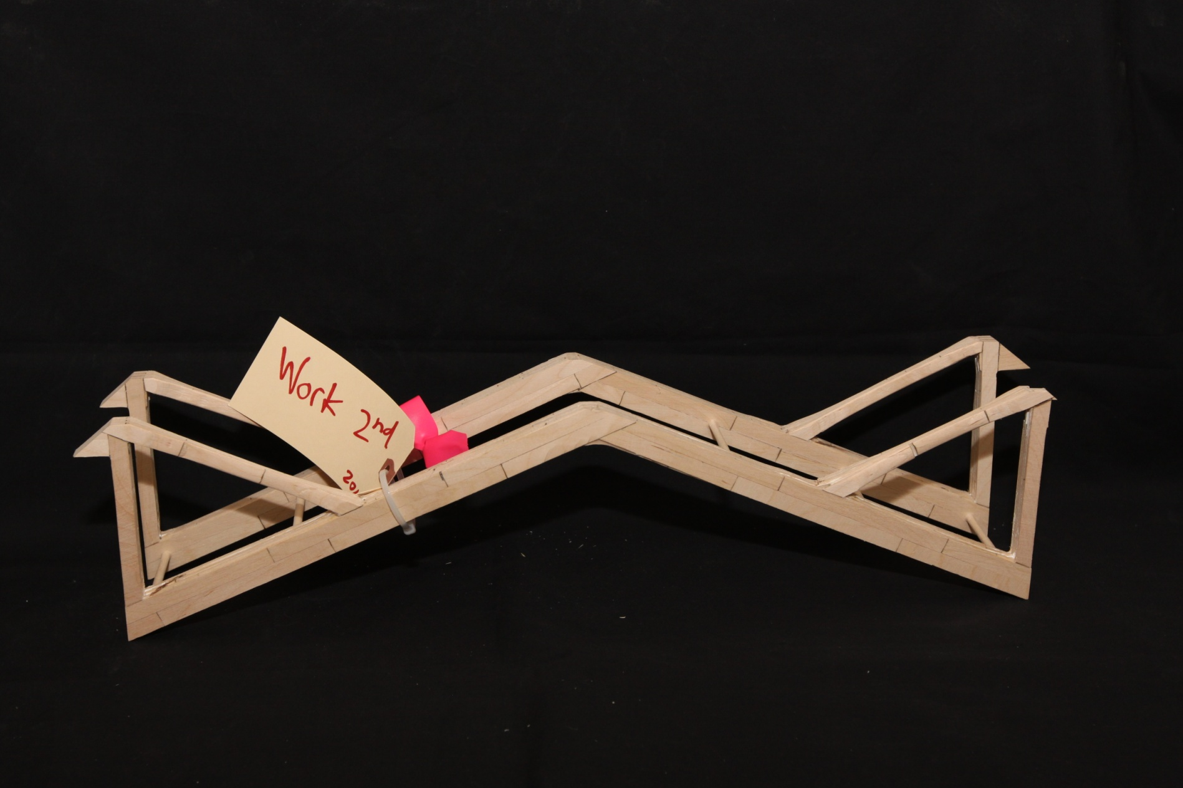
Best Workmanship 2nd Place
Bridge Weight = 241.2g
Performance Rating = 1033.2 times own weight

Slide 21
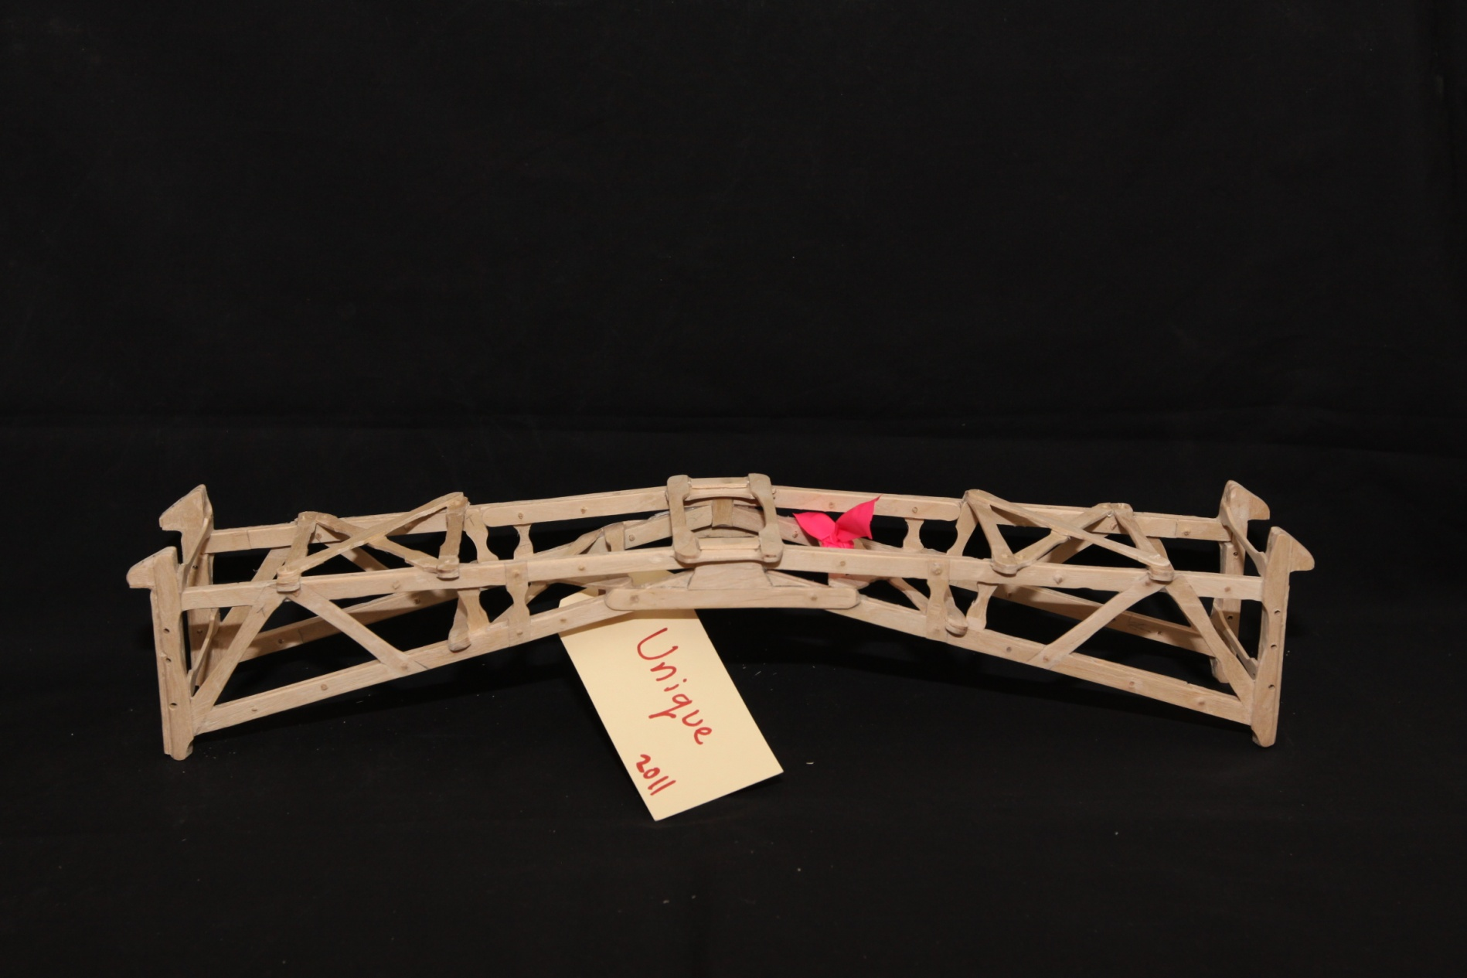
Most Unique: Ed Kollee
Bridge Weight = 145.1g
Performance Rating = 1006.9 times own weight

Slide 22












A Special Thanks to all of our Sponsors
CRUNCHBOOK 2011

