Slide 1

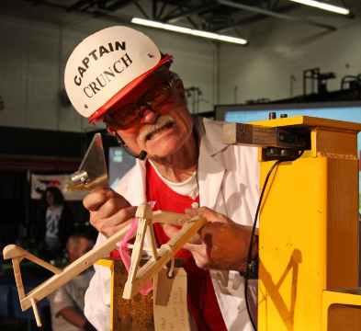
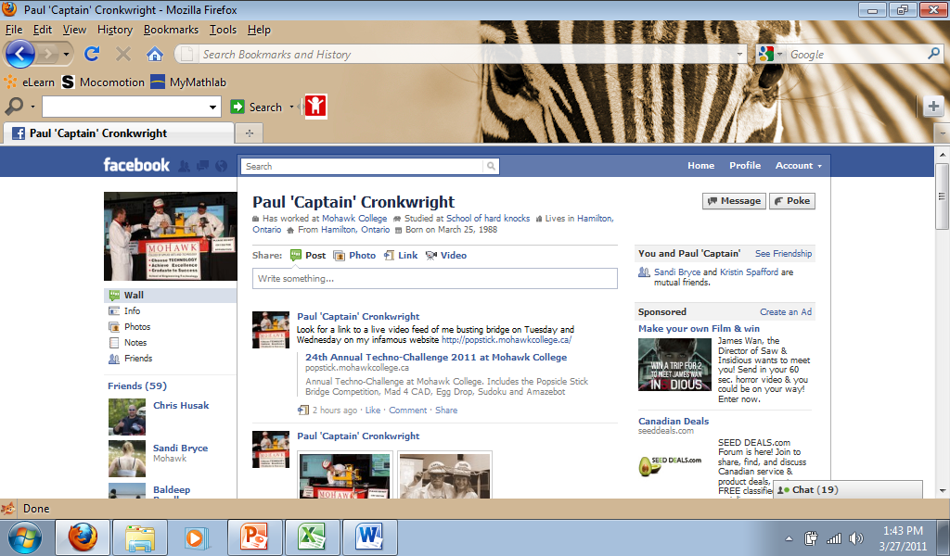
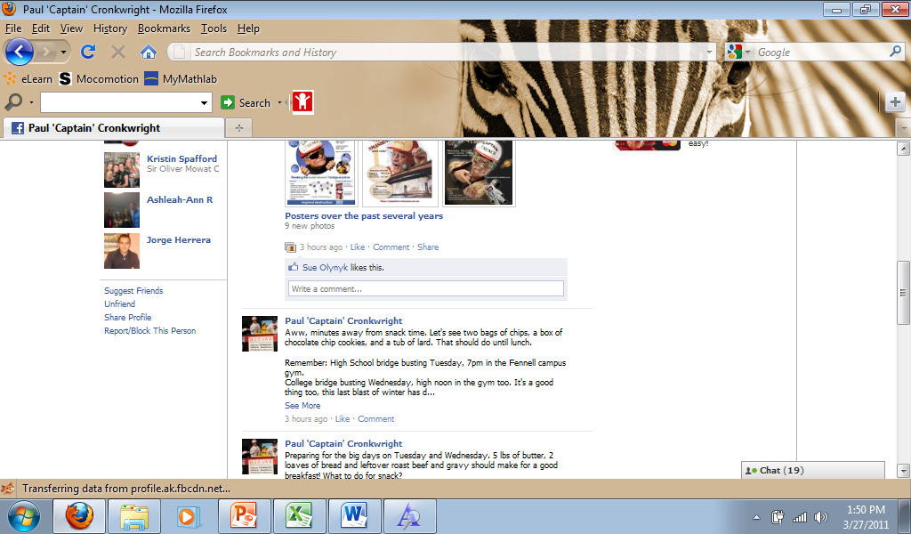


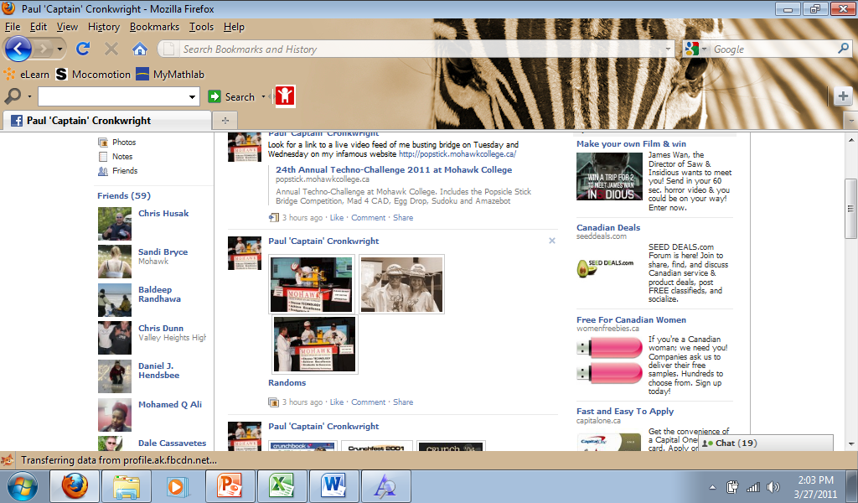

Paul ‘Captain’ Cronkwright
CRUNCHBOOK 2011
2011 High School Prize Winners Gallery. I busted them all… LOL!!!

Slide 2
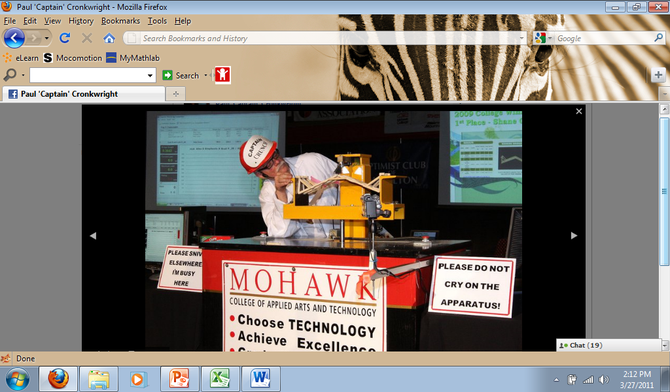
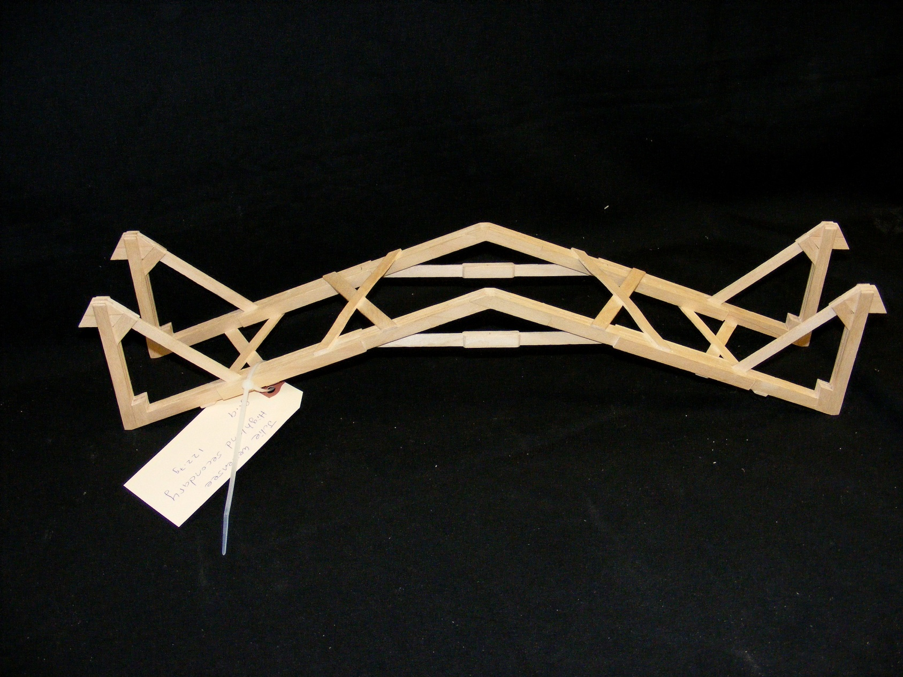
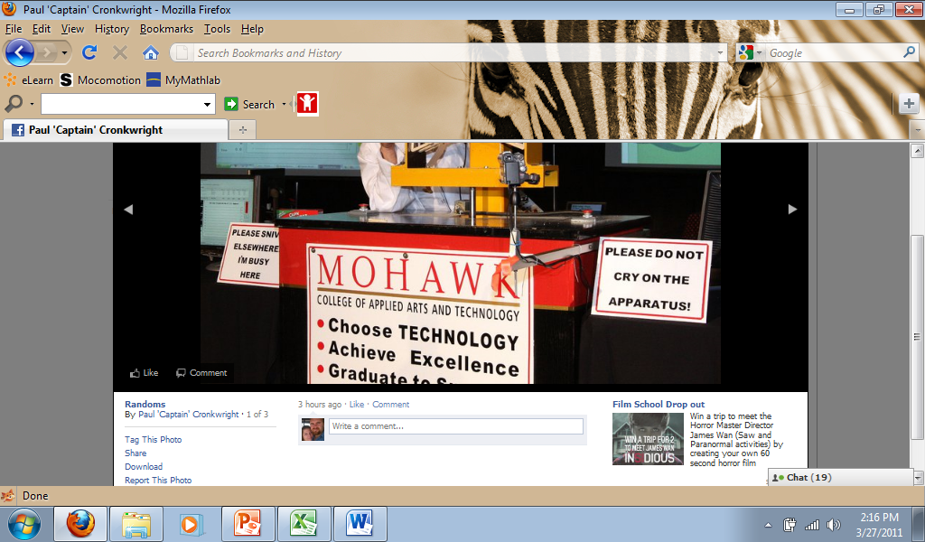
1st Place Overall, Best Performing Jr and Best Workmanship Jr: Julie W Bridge Weight = 122.7g Performance Rating = 2946.4 times own weight

Slide 3
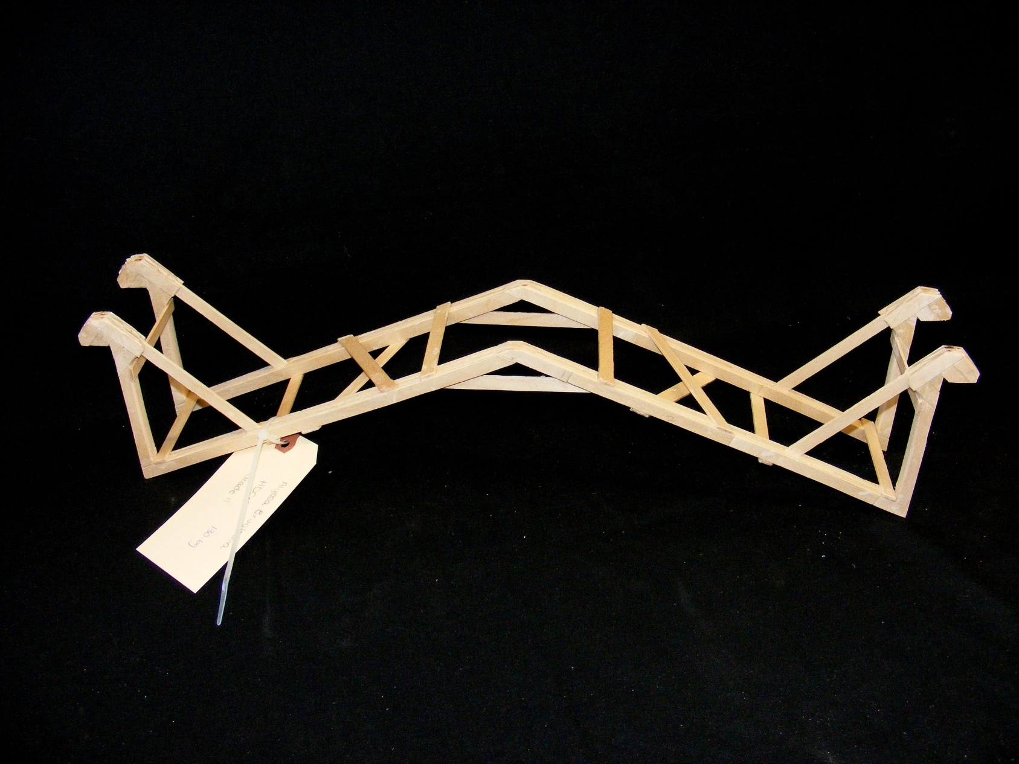
2nd Place Overall: Alyssa B Bridge Weight = 130.6g Performance Rating = 2496.0 times own weight

Slide 4
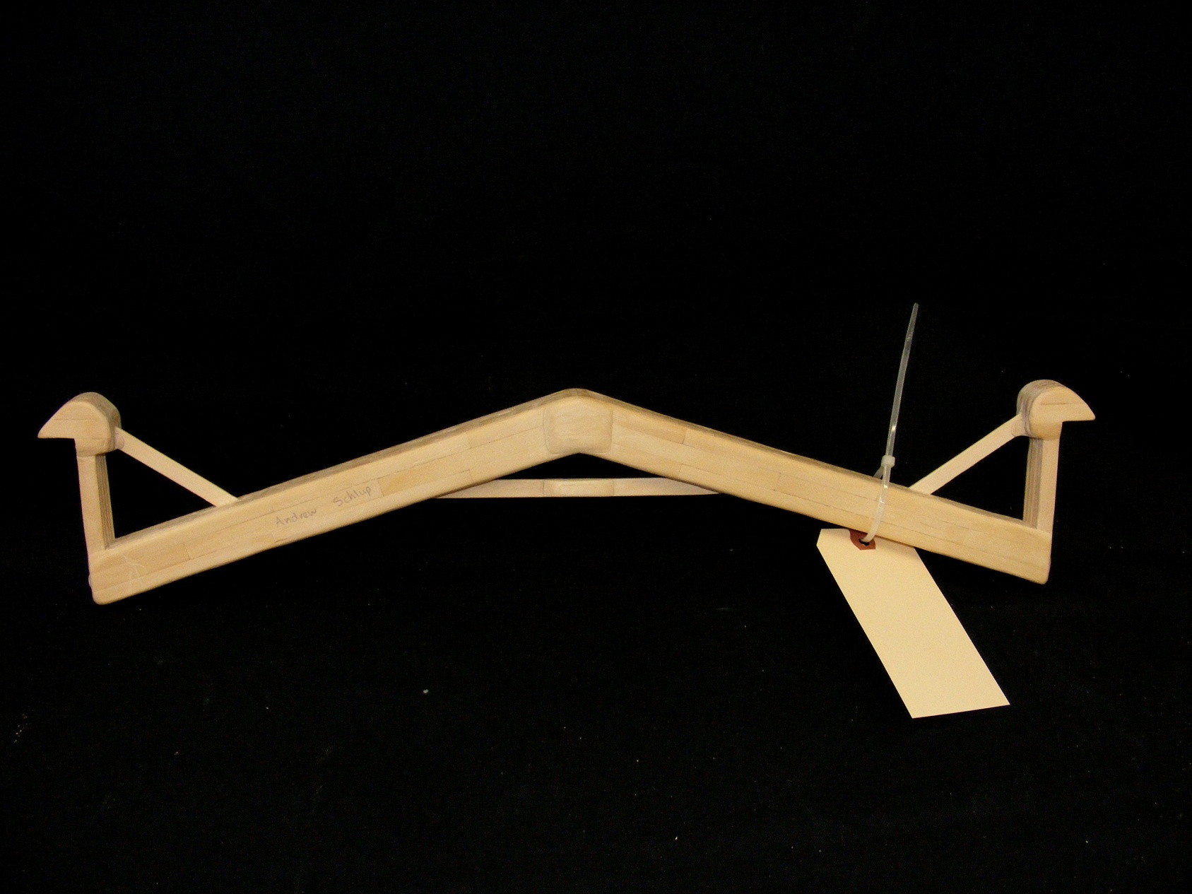
3rd Place Overall and Best Aesthetics Sr: Andrew S Bridge Weight = 242.7g Performance Rating = 2170.1 times own weight

Slide 5
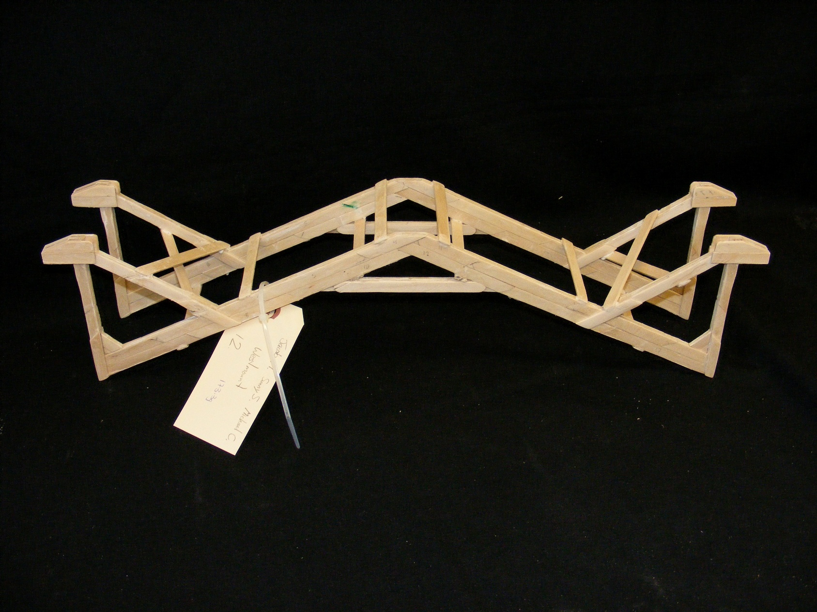
4th Place Overall: Jacob M, Sunny S and Michael C Bridge Weight = 173.3g Performance Rating = 1852.4 times own weight

Slide 6
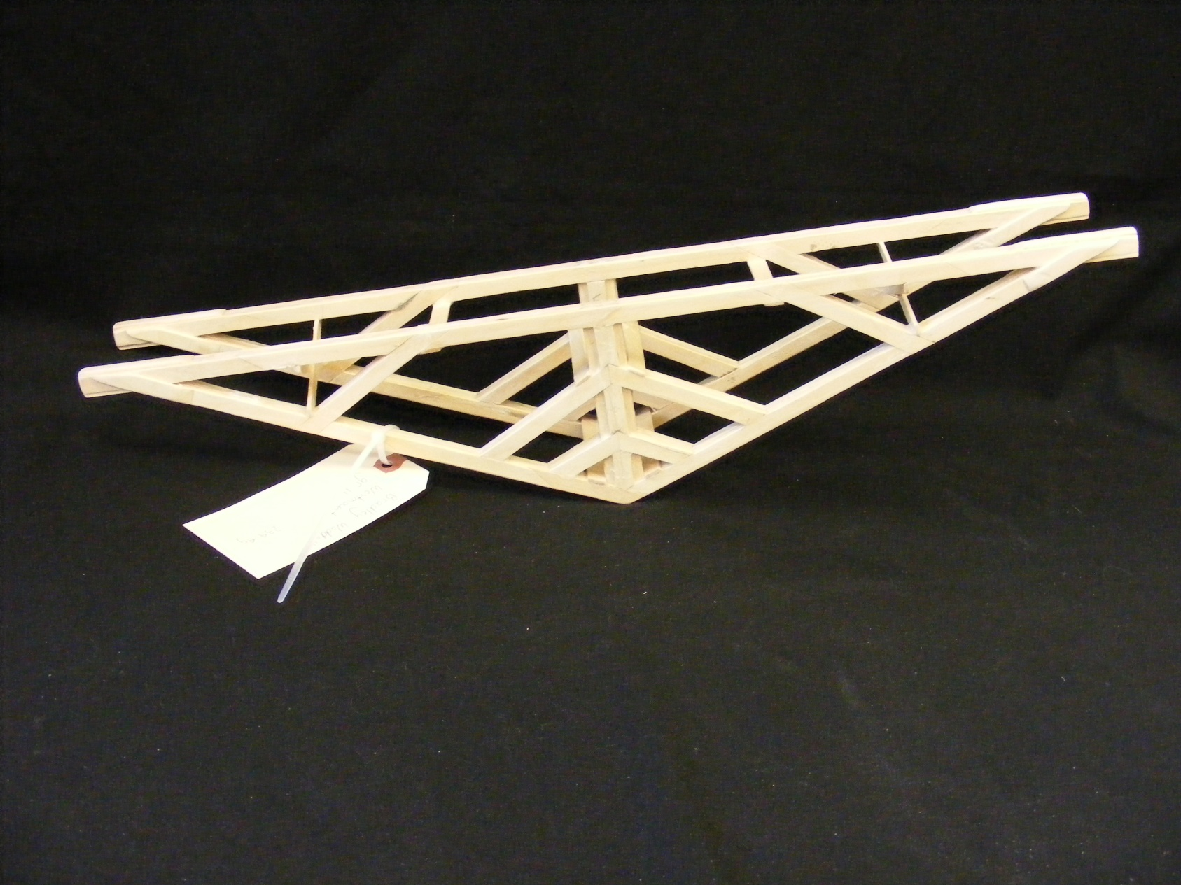
Best Performing True Truss and Best Workmanship Sr: Bradley W Bridge Weight = 234.4g Performance Rating = 1183.9 times own weight

Slide 7
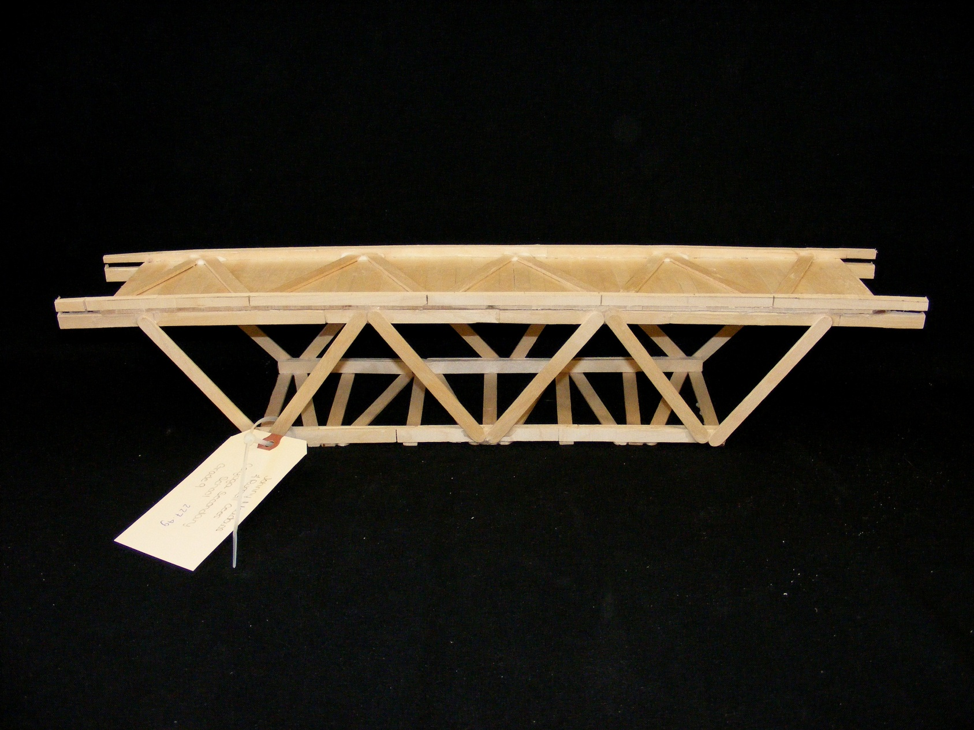
Best Aesthetics Jr: Johnny M and Russell C Bridge Weight = 227.4g Performance Rating = 191.7 times own weight

Slide 8
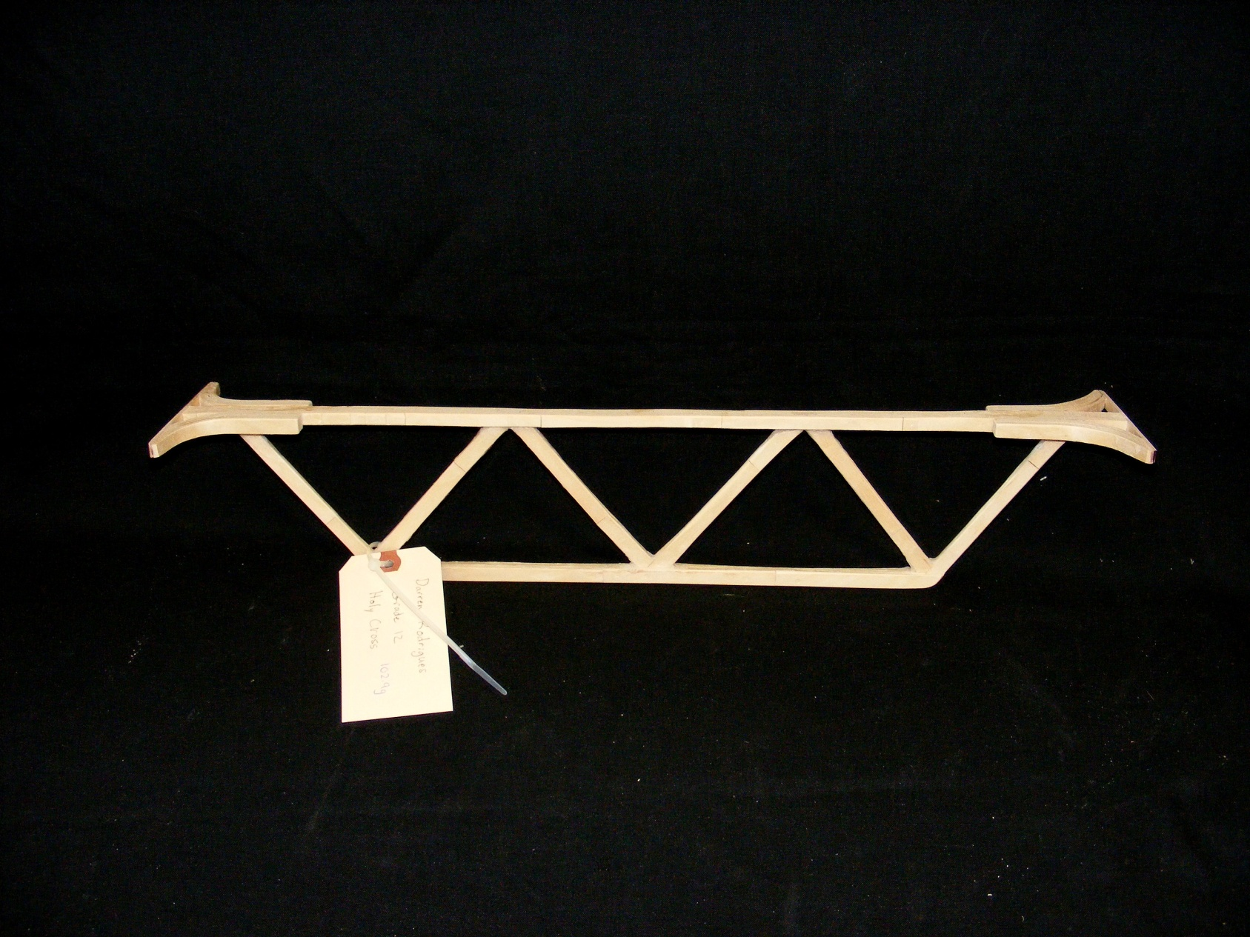
Most Unique: Darren R Bridge Weight = 102.9g Performance Rating = 483.1 times own weight

Slide 9








CRUNCHBOOK 2011
A Special Thanks to all of our Sponsors

